Slide 1

React Session 1
29/09/2023
Plan and Setup
Code Mentor Mauritius - React Sessions – Full Stack Web Development

Slide 2
Agenda
Setup
React Components
Code Mentor Mauritius - React Sessions – Full Stack Web Development

Slide 3
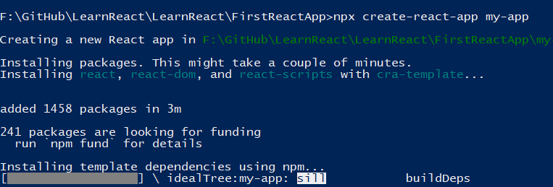
Creating a React App
npx create-react-app appName
Start React project
npm start
Create React App (create-react-app.dev)
Code Mentor Mauritius - React Sessions – Full Stack Web Development

Slide 4
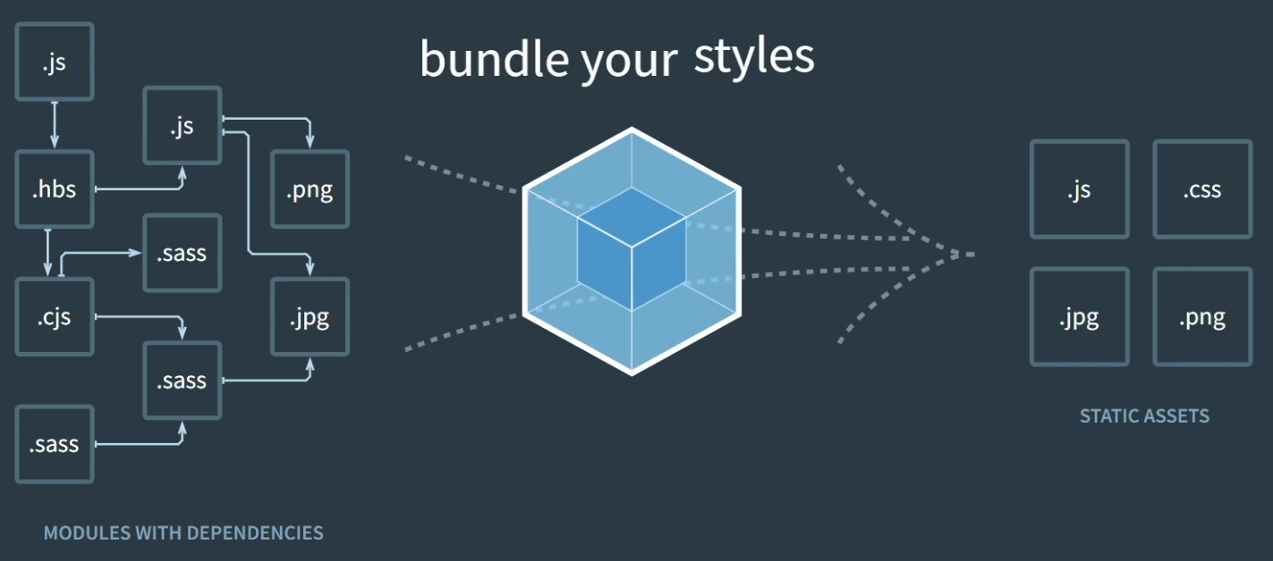
What is Webpack
It’s a Module bundler
Combines all your JS files into a single file that can be used by the browser.
Code Mentor Mauritius - React Sessions – Full Stack Web Development

Slide 5
Components in React
Define a component in Src\App.js
function MyComponent() { return<p>HelloWorld</p>; }
Calling JSX components:
<MyComponent />
Component with Props
function MyComponentWithProp(props) {return <p>props</p>;}
<MyComponentWithProp name="Hello World!" />
Code Mentor Mauritius - React Sessions – Full Stack Web Development

Slide 6
Conditional Rendering in React
Define a component in Src\App.js
function MyComponent(value) { return if(value==1){<p>HelloWorld}</p>;}
Calling the component
<MyComponent value="1" />
Code Mentor Mauritius - React Sessions – Full Stack Web Development

Slide 7
Loops in React
function ListOfFruits() {
const data = [ { id: 1, name: "Apple" }, { id: 2, name: "Banana" }];
return (
<ul>
{
<li key="{id}">name</li>
</ul>);}
))}
data.map(({ id, name }) => (
Code Mentor Mauritius - React Sessions – Full Stack Web Development

